Slide 1
AI and Machine Learning
© Templateswise.com
Genre Classification Project
Students: Ali Al Moussawi – Mostafa Jaloul
Instructor: Dr. Ali Komati

Slide 2
Agenda
Introduction
How all done?
Conclusion

Slide 3
Introduction
Project IDEA
PROCESSING
TESTING
Music Genre Classification Automatically classify different musical genres.
WE USE A DATASET CONSIST OF 10 GROUP OF GENRES CLASSES WITH SIZE ABOUT 1 GEGA BYTE
Download new music from outside and test our model.

Slide 4
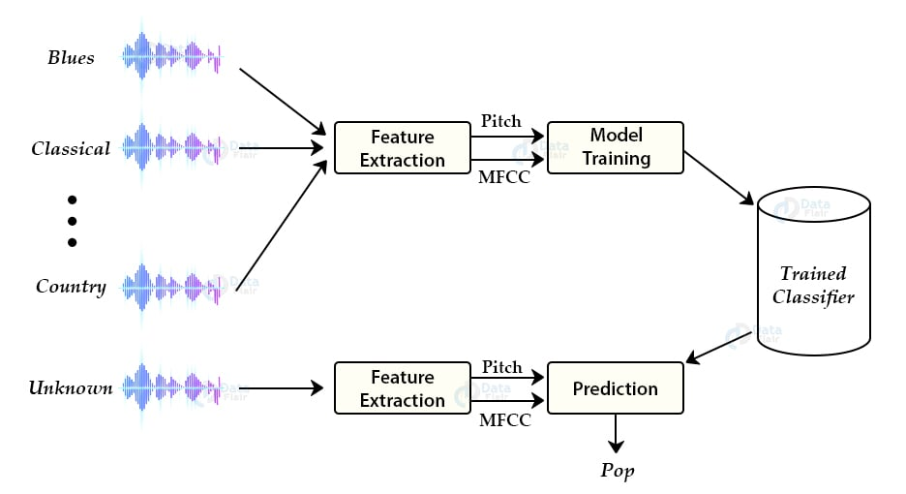
How all done?

Slide 5
Work process
Download the training dataset Gtzan that consist of 10 different classes of music genres
Split the data into two parts: training and testing.
We download some models (knn – logistic expression) from internet.
Start training our models and save their state for future work, because we don’t need to train our models every time. So, we saved them in pickles.
We worked on the frontend part using flask framework in python (we create a simple page that take input music and print the output on it).
Finally, to the testing part.

Slide 6
Testing part
Take unknown music
Model will split it into 10 parts , and remove the parts with no sound
After extracting features from each part like MFCC or pitch. Each part will go through our model and gives us the result. The more classes gained the more genre wins

Slide 7
Conclusion
So, we talk about what its music genre classifier, how it works, and how it classify our music’s. Now, lets make a demo !
Thank you!

